Slide 1
“ALLEVIATE AID ADVISORY”
ABHISHEK KUMAR PRAJAPATI(LEADER)
Sinesh Kumar

Slide 2
Project Idea
● A portal which is helpful for users to predict their diseases by taking their symptoms.
● We also provide cure and medications for the disease.
● We also provide an option for user where they can add their family members and see their profile.
● We also provide risk calculation details to users as at what stage they are with disease.
● We also provide facility for users to interact with doctors in case if he/she have some personal problems.

Slide 3
Project Aim
● Our Project mainly focuses on providing quick cure and medications to users after predicting their diseases.
● It might be helpful in rural areas where we see that many people are facing problems due to late and wrong treatment.
● Target the rural area where almost no Hospital/Doctor is available.
● Risk factor help users in getting treatment at right time.

Slide 4
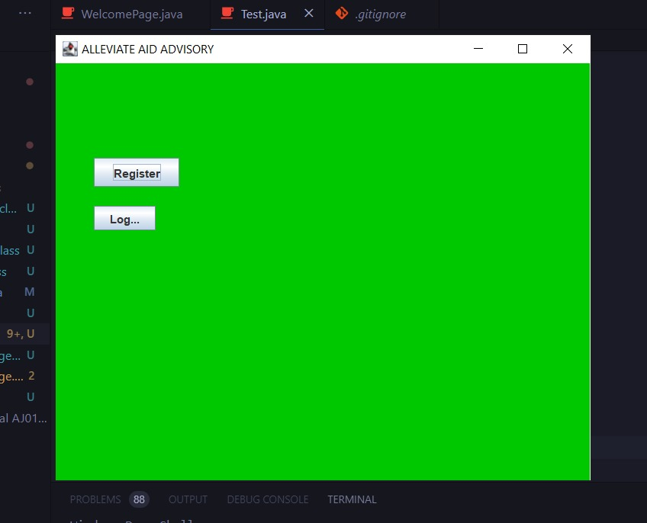
Registration Page

Slide 5
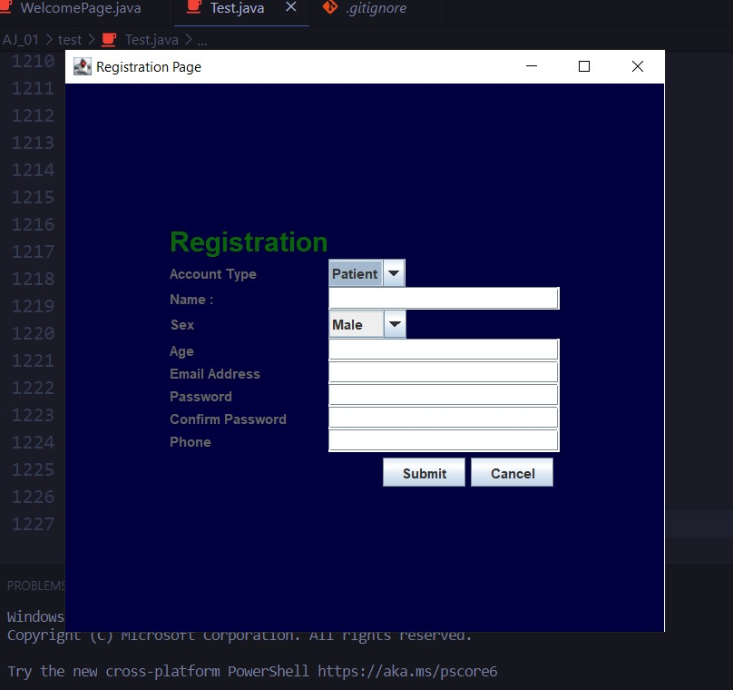
Registration Details Filling

Slide 6
Registration Features
In this Page user has to register himself/herself. Also, user has option to add his/her family details if he wish to do so.
User also has option to see his family members details so, that he/she can see family details.

Slide 7
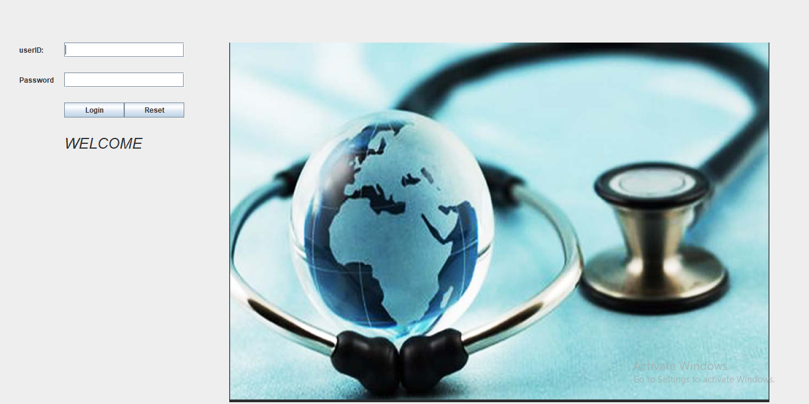
How Our Login Page Looks

Slide 8
Project Features
HOSPITAL TIMING-> In this Page user can able to see all hospitals details like hospital timing, hospital cases etc. according to their location.
Medicine Issues->In this Page user can able to see list of all Common Medicines which migt be helpful as a “First Aid”.

Slide 9
Continuation of features…….
Doctor’s Advice-> In this Page if user wants to take any advice/details he can ask to Doctor, we will record that query and send to concerned doctor.
Patient Help-> This is our main Application Page where user can give his/her disease symptoms and we will give “which disease he is facing” and also provide medications/cure to that disease.

Slide 10
Features Continuation…….
RISK Calculation-> After predictng disease, In this page we will calculation “how much risk he has with that disease”. It helps users to take actions against disease accordingly.

Slide 11
Project Targets
We are planning to use ML in this project, so that we can easily help users.
We also try to connect with Doctors so that we can help users on time.
Also we are planning to launch this project as an App.
Upto now we are presenting as an PORTAL.

